Slide 1
Shiny tutorial – Part II
Alex Fulk
Notes:
Hello everyone, last we started our tutorial on how to use shiny apps and we’ll be continuing that this week.

Slide 2
Content covered so far
Build an app
How to create reactive applications using input and output functions
Sharing your application
Notes:
So far we have learned
-how to build an application
-how to create reactive applications using input and output functions
-how to share your application using shinyapps.io so that others can utilize it
We also covered how shiny applications are maintained, using an open r session on either a computer or online server and we looked at a template that should be used for every shiny application that you create. Today, we’ll be focusing on the server function and creating more reactivity within your applications.

Slide 3
WHAT IS REACTIVITY?
Notes:
First, I want to give a more intuitive explanation about reactivity in shiny applications. It’s helpful for me to think of this in terms of excel.
GO TO BLANK EXCEL

Slide 4
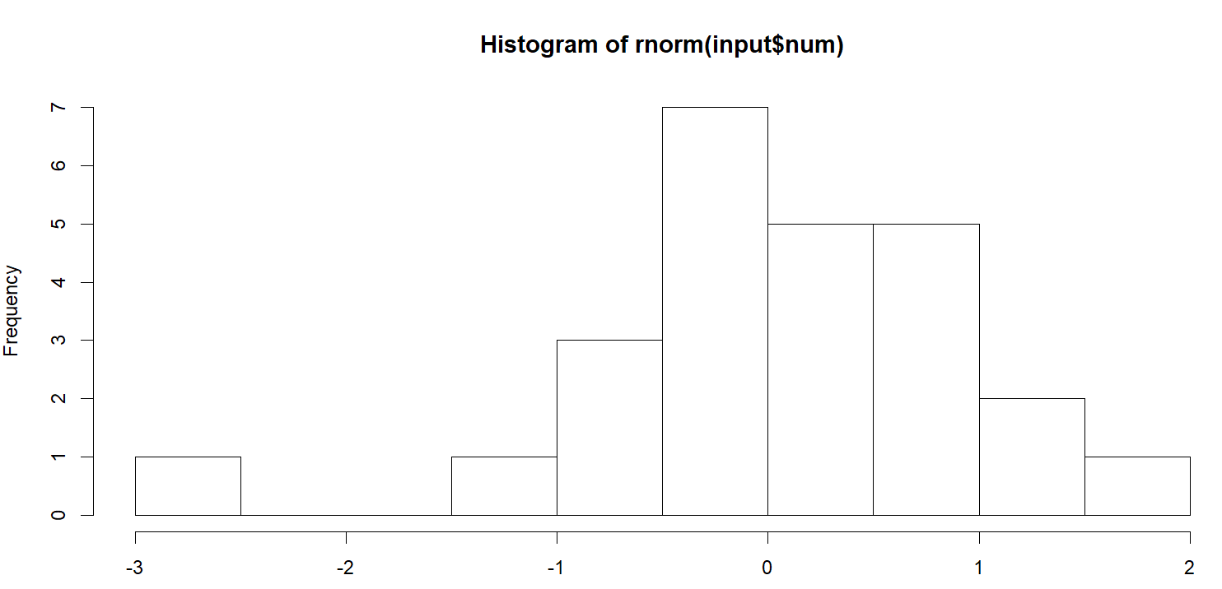
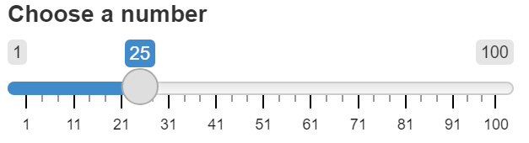
Reactivity in shiny
output
input
Notes:
In the example that I introduced last week, out input parameter was the quantity of numbers drawn from the normal distribution and our output was the plot showing the results via a histogram. This is only a surface-level example of the reactivity that is possible with shiny. For instance

Slide 5

Reactivity in shiny
code
input
output
input
Expression()
output
Notes:
We can have a change in an input value simultaneously trigger some arbitrary code to run on the side as well as update out output
-or we can extend the reactive chain to create additional objects that react to changes in our inputs and provide updates for our outputs
-we can add an update button that allows for a change in input only after the user presses it. And these are the kinds of things that we’ll be covering today. This will also make your application much more interesting of an experience for the user.

Slide 6
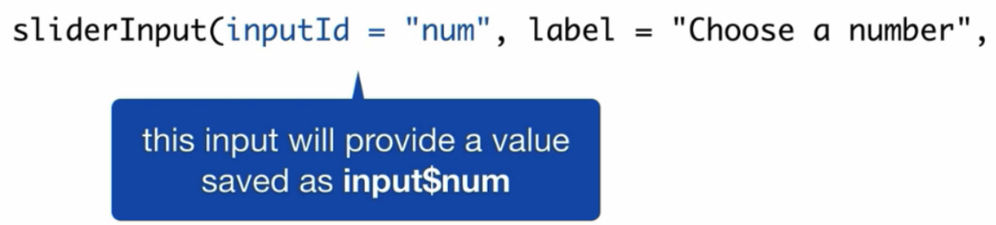
Reactive Values
Notes:
We’ll start with reactive values since that’s where reactivity will typically begin when building your shiny application. Going back to our simple example again, the slider gave us a reactive value that changes depending on the user input. This is different from typical values in r that normally only change when a piece of code tells them to do so.

Slide 7
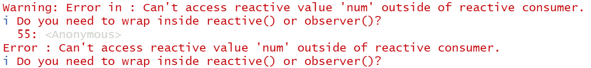
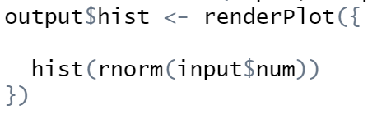
Reactive values
Reactive values don’t do much on their own
Notes:
It’s important to note that reactive values don’t do anything other than change on their own. They need to be paired with a reactive function that expects to take reactive values and knows what to do with them when they are changed.
-renderPlot is the reactive function that we paired with our slider input to get a reactive histrogram. If you forget to place hist(rnorm(inpout$num)) inside of a reactive function, then you will get an error message.
-this is the error message that you’d get if you tried to generate a plot using a reactive value outside of a reactive function. As you can see, you will receive an error telling you that you placed a reactive value outside of a function that is designed to handle it. There are also observers, which we’ll talk more about on the next slide.

Slide 8

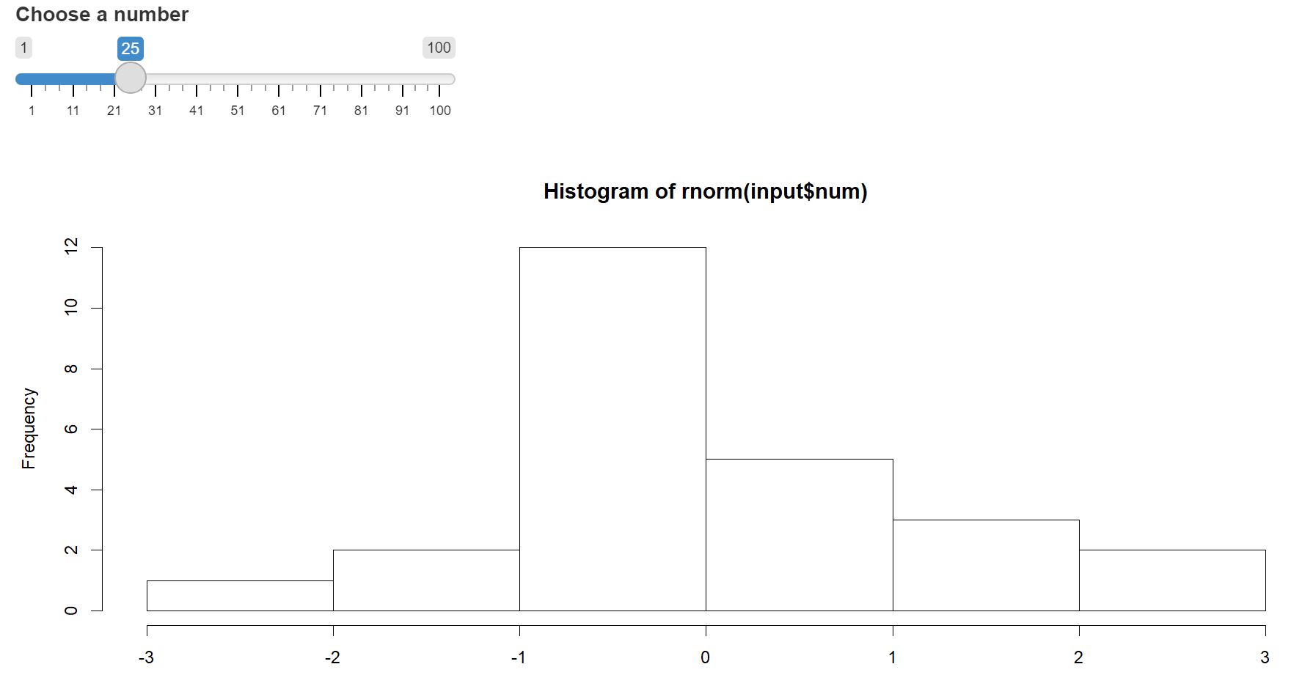

A two-step process
Notes:
Reactive values paired with reactive functions can be thought of as a two-step process. In our example, we have a reactive value that is placed inside of a reactive function that uses input$num to create an object and save it to output$hist. The object created by the reactive function is called an observer. The observer and the reactive value combined create the reactivity in the application.

Slide 9
A two-step process
Reactive values notify the functions that use them when they become invalid
Objects created by reactive functions respond when notified by reactive values
Notes:
Now reactive values have one job, and that is to tell reactive functions that their value has changed.
-this gives us the first step in our process and that is that reactive values notify the functions that use them when they become invalid.
-Then this initiates the next step, where the reactive function, or more precisely the object created by the reactive function does its job. The job of the object is simply to respond in some way. Different objects created by different reactive functions will respond differently to changes in input values. An object created by a render function has the job to rerun the code that is placed within the render function and update itself. For our example, once notified, the object created by renderPlot reruns the code, looks up the new value of input$num and updates the object saved to output$hist. You can customize the response of a reactive function by using different ones that give you different reactivity. We’ll go over some different reactive functions and what they can do, but first let’s do a quick recap on reactive values.

Slide 10
Recap: Reactive values
Reactive values act as data streams that flow through your app
Input list is the list of reactive values that hold the current state of inputs
Reactive values can only be used inside of reactive functions
Reactive values notify. Objects created by reactive functions (observers) respond to the notification
Notes:
-reactive values act as data streams that flow through your application. Changes in these values will initiate changes in other aspects of your application.
-the input list in your server function is a list of all reactive values and it contains their current state or value
-Reactive values can only be used inside of reactive functions which are specifically designed to handle reactive values
-reactive values will notify the observer when its value ahs changed. Then the observer will do whatever it is designed to do when a value changes, typically rerun a block of code and update an output.

Slide 11
Reactive functions
Using code chunks to build (rebuild) an object
What code will the function use?
The object created responds to a certain set of reactive values
What reactive values will the object respond to?
Notes:
There are only 7 functions dealing with reactivity that you’ll need to know in detail to completely control the level of reactivity in your application and we’ll go through each type one-by-one. However, there are a couple of things to keep in mind regardless of which kind of reactive function you are working with
-first, you will be using a chunk of code to build and rebuild an object
-once this object is created, it will respond to a certain set of reactive values
-in order to have a firm understanding of the reactivity in your application, you’ll need to know what code your function will be using to build and rebuild an object
-and what reactive values said object will respond to

Slide 12
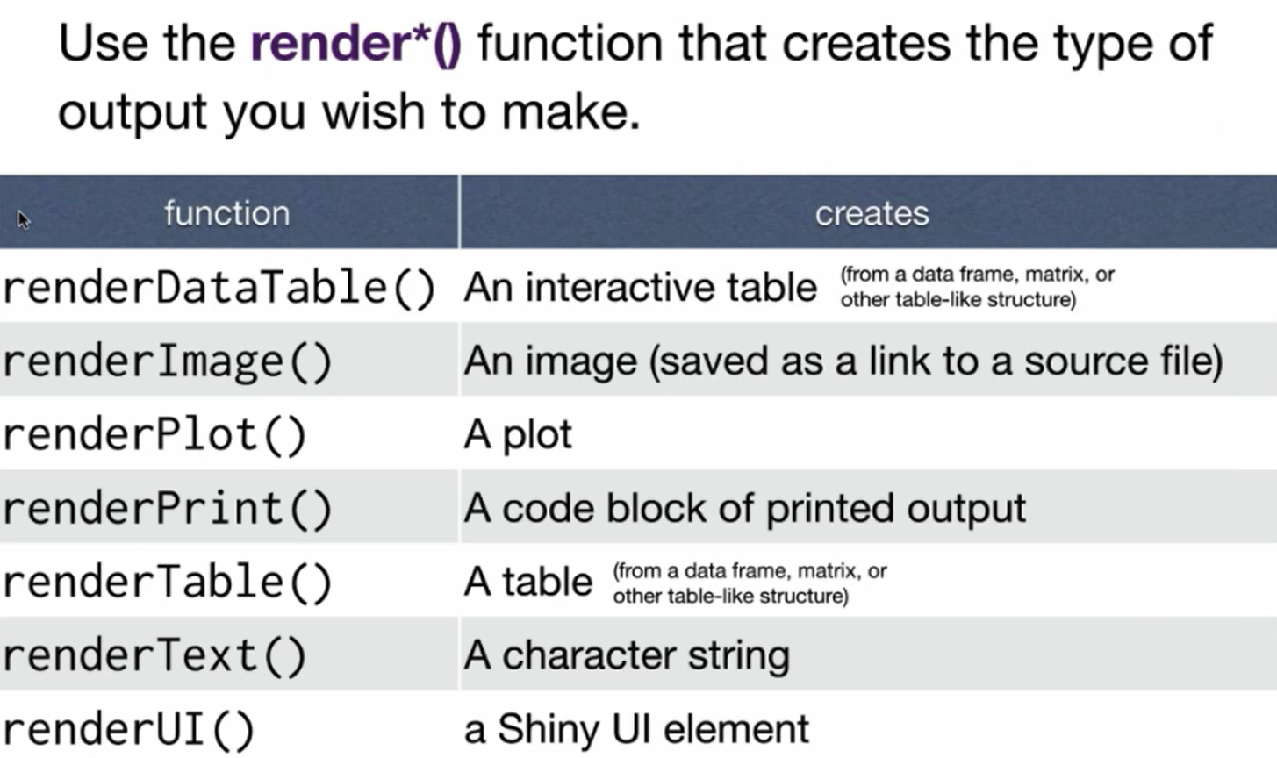
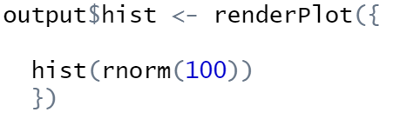
Render functions
Notes:
The first set of reactive functions that we’ll go over are a group that we’re already familiar with: render functions. With these functions, you’ll be passing some argument into the render function and get an output that is displayed on your shiny application. Some of the most commonly used are renderPlot, and renderTable
-these functions take a single input, that is a block of code. This block of code is placed between the curly braces and can be as long of short as is needed to build the object being rendered. These functions will also respond to any reactive values that are inside of the block of code given in the curly brackets. Whenever a reactive value that is inside the code block is changed, the rendered object is made invalid and the code block is run again with the new reactive value. This is important to keep in mind, especially if you have a block of code that is hundreds of lines long as this can make your application run slowly.

Slide 13
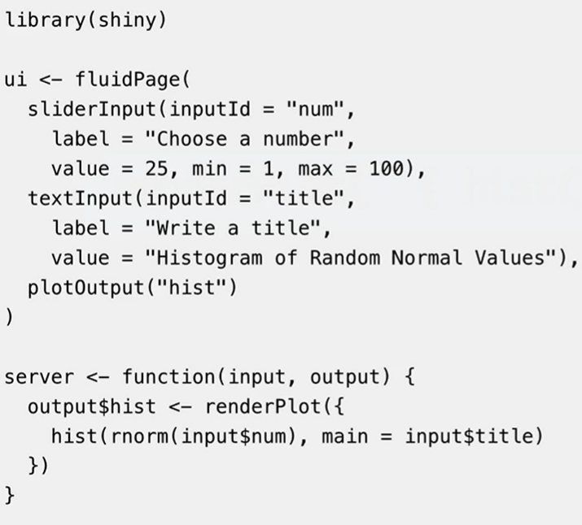
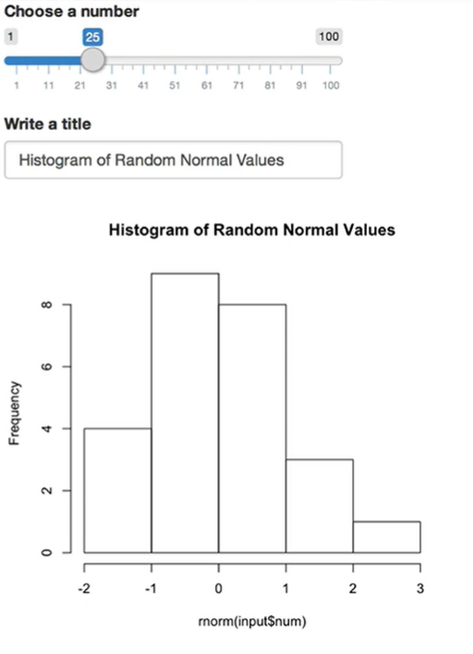
Render functions
Notes:
Now, let’s take a look at that process via an example. This is a very simple example, similar to the one that we went over last week, that has two reactive values, the slider value and a title that can be changed by the user.
OPEN EXAMPLE IN R AND EXPLAIN

Slide 14
Recap Render functions
Render functions make objects to display in your application
Always save output to output$
Render functions make an observer that has a block of code associated with it
This entire block of code is rerun every time the render object is notified that it is invalid
Notes:
-Render functions make objects to display in your application
-Always save output to output$ whatever you named the output in the ui section as this is the only way to get a rendered object ot actually display in your applicaiton
-Render functions make an observer that has a block of code associated with it
-This entire block of code is rerun every time the render object is notified that it is invalid. So, now let’s make things slightly more sophisticated.

Slide 15
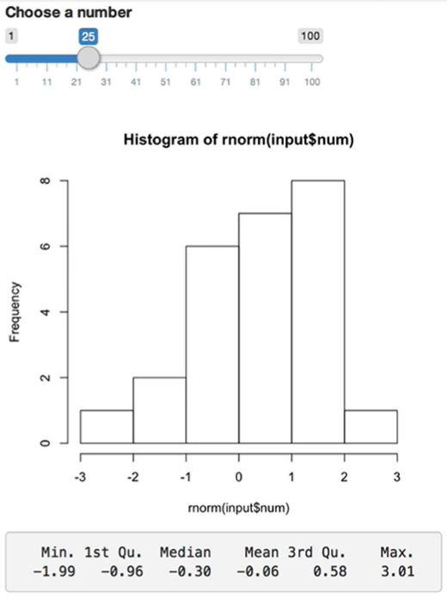
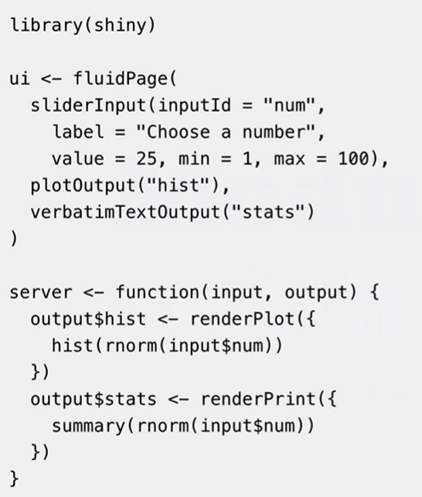
Example 2
Notes:
Here is another example, again similar to ones that we have seen previously, however this one has a single input again, but two outputs, one being the histogram and another being a set of summary statistics given by the summary function in r. If you’ll notice in the code, we call rnorm(input$num) in two places. This is important because that means that each time input$num is changed, it will subsequently run both portions of code and this means that the numbers associated with the histogram are not necessarily the same as the numbers used to calculate the summary statistics. Thus, it would be helpful if we could save the dataset generated by rnorm(input$num) to a variable so that we are using same dataset for each output. However we need to do this in such a way that we also tell out outputs that they are invalid when input$num changes, so we need to use a reactive function of some kind and it wont be as simple as saving your dataset to a variable.

Slide 16
Reactive()
reactive() gives us the functionality that we need to accomplish this!
Reactive expressions are technically functions and must be called as such (data())
Notes:
The reactive() function gives us the functionality that we need to save a reactive dataset. Just like render functions, we place a block on code inside curly brackets as an argument for the reactive function, then every time input$num is changed, this reactive function will be notified that it is invalid and notify subsequent output objects that they are invalid, then the output object will rerun the block of code associated with them and in the process, call the value of data(), then the reactive function will rerun its code to update the value of data and return that to the output objects, and whether the data save be a number, a matrix, or some other object (which is known as a reactive expression), it is updated and sends that updated value to any observers that have asked for it.
-reactive expressions are different from typical r objects and that’s because they are technically functions, so when calling a reactive expression, you’ll need to use paretheses as you would with any other function in R

Slide 17
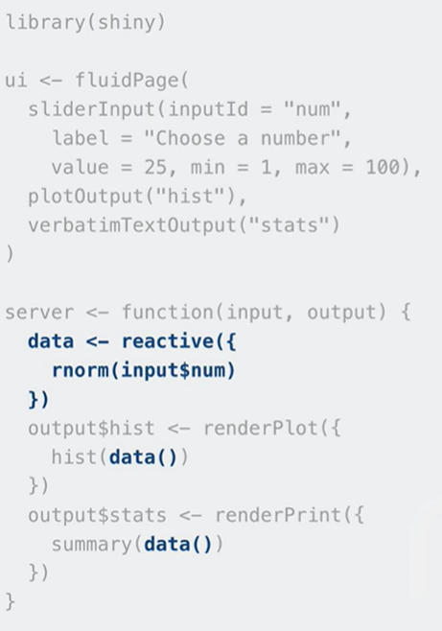
Example 2
Reactive expressions cache their value until it is notified that it is invalid
Notes:
Going back to the second example, we can change the portion of the code that access input$num twice inside of the server function.
-instead of doing that, we can create our dataset using the reactive function and call that dataset using data(). This will allow our histogram and summary statistics to be updated using the same data. Now when our reactive expression created using the reactive function is notified that it is invalid, it will pass this notification onto our output objects created by our render functions that they are invalid. Then, the objects will rerun their code and call data() tog enerate their objects again. The reactive function will then update its value by rerunning the code block that is associated with it, in this case rnorm(input$num) and send those results to whichever object called it first, in this case it would be the object output$hist.
-Here is another way that reactive expressions differ from other types of r objects. They know whether or not they are invalid, so when the object created by output$stats calls for the value of data(), our reactive expression will not rerun its code again since it knows that it is still valid and will simply return the dataset that it computed when it was called by the object created by output$hist.

Slide 18
Recap on reactive() function
reactive() makes an object to use (later in your application)
Reactive expressions are themselves reactive, so we can use them to modularize your code
Call a reactive expression like a function
Notes:
Another quick recap on everything that we just covered concerning the reactive function
-reactive makes an object to use later in your application
-Reactive expressions are themselves reactive, so we can use them to modularize your code and make it more efficient since they cache their values and prevent unnecessary reruns of code
-call a reactive expression like a function
-

Slide 19
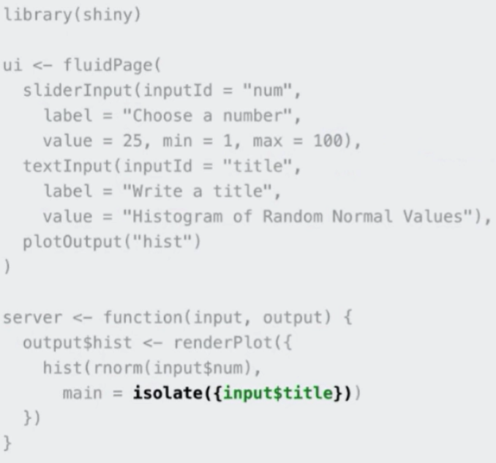
Another useful function: Isolate()
Notes:
Looking back to our first example, the way that we currently have it written means that our plot will update whenever we change our title, however it may be the case that we want our histogram and title to update only when we change the slider value. To accomplish this, we simply introduce the isolate function into our title code.
-this will allow the title to change only when the slider value is changed, in other words, changing our title will not update our histogram and the title on the histogram will not change until a reactive value tells it that it is invalid. Once we wrap input$title in the isolate function, this makes input$title no longer reactive, so it cannot notify our output object that it is invalid, only input$num can do that now
SHOW IN EXAMPLE

Slide 20
Content covered so far
code
input
output
input
Expression()
output
Notes:
-So far we have covered how to create reactivity using render functions,
-how to extend that reactivity using the reactive function, and how to break that reactivity using the isolate function,
-so now we will move onto how to trigger additional code to run when a user inputs a value. This is code that your user often will never see and we’ll get into some examples in a minute. To accomplish this, we need to use a new type of input object, called an action button

Slide 21
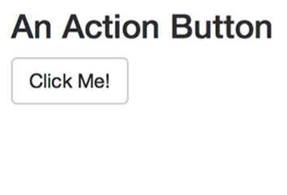
Action buttons
Notes:
-the syntax of action buttons is the same as that of sliderInput that we have used previously. You have an inputID that is for referencing within your code, as well as a label that will be displayed over the button itself. You can input this into the ui section of your application and run and you’d see the button with “click me!”, but nothing would happen if you clicked since you haven’t told the application what to do on the server side of things.

Slide 22
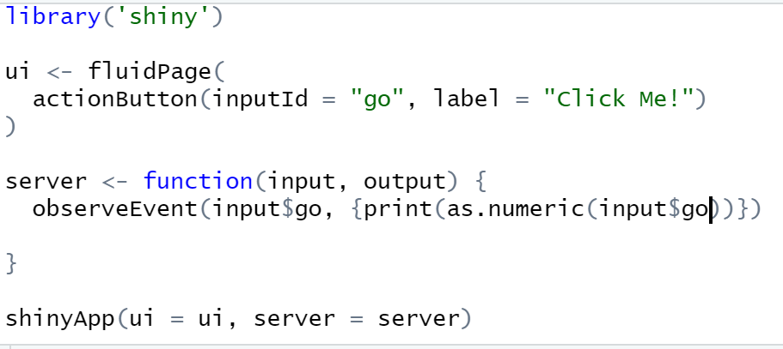
Observe event function
The observeEvent() function enables the reactivity of the application to action buttons
https://shiny.rstudio.com/articles/action-buttons.html
Notes:
The observeEvent() function enables the reactivity of the application to action buttons. It will trigger code to run on the server side when the event given in the argument is observed.
-let’s say we write a piece of code like this, then we have a reactive application, but it’s important to understand that oberserveEvent does NOT display anything on your application unless the object created by it is passed into a render function and subsequently called in the ui section of the code. You also don’t need to save the output of observeEvent to anything, it will keep track of its value on its own. For more detail on how to use action buttons in your own applications, I’ll refer you to this website
EXPLAIN NUMBER THING IN R CONSOLE WHEN USING OBSERVEEvent (NEVER WANT YOUR CODE TO DEPEND ON THE VALUE OF THE ACTION BUTTON, only on the fact that it was clicked
GO TO ACTION BUTTON EXAMPLE IN R

Slide 23
Observe
observe() is another function that is analogous to observeEvent()
Notes:
observe() is another function that is analogous to observeEvent(), it does the same thing, however its syntax is more similar to that of render functions, and the reactive and isolate functions that we talked about today in that it waits for some input value to change and when it does, it will rerun its code and be updated. You can use observe if you’d like, but observeEvent is more typical and arguably more intuitive in its design, so I recommend that.

Slide 24
Recap on Obeserve event
observeEvent() triggers code to run in the background
Allows for specificity in which values invalidate the observer
You have the option to use observe() which is a more implicit way of doing everything that observeEvent() can do
Notes:
-observeEvent() triggers code to run in the background. This is useful for doing things like connecting to another server or downloading data that will be used in your application.

Slide 25
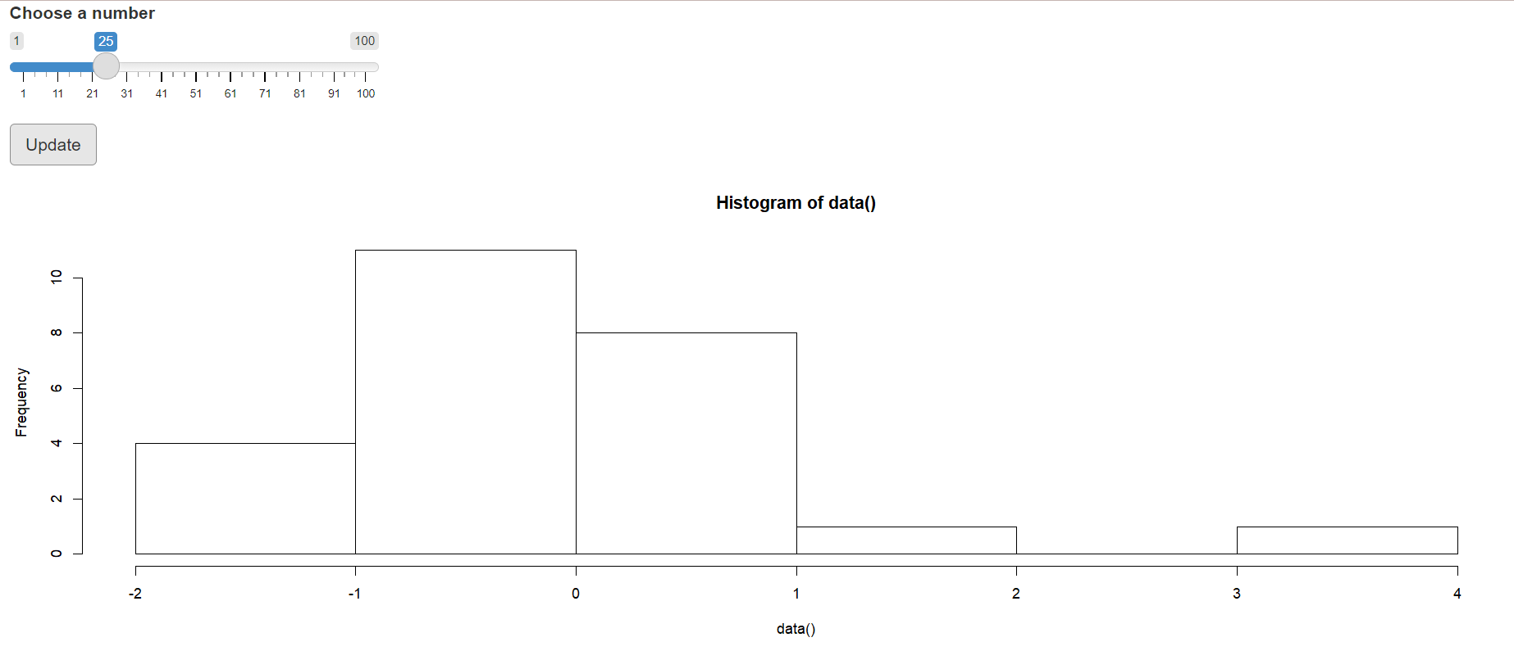
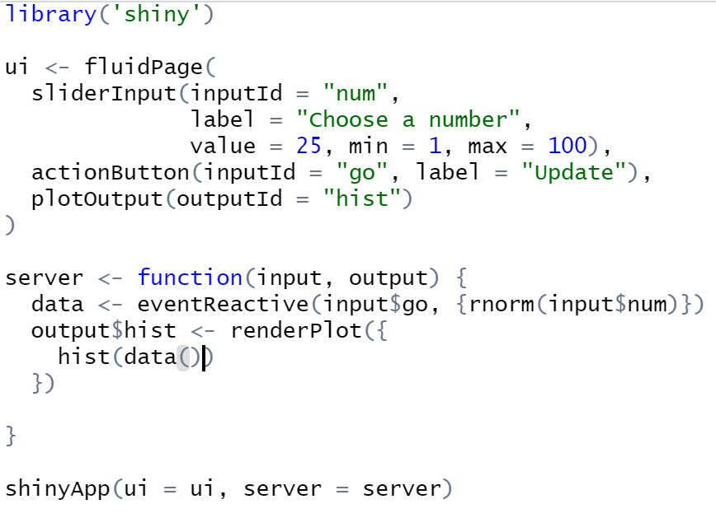
Delaying reactions
Using eventReactive()
Notes:
Moving onto another important concept when designing a shiny application, what if we’d like to delay a reactive component of ours from updating until the user tells it to? That is what we’ll be looking at in this section of the tutorial.
-going back to the main example from last week, what if we wanted the histogram to update only when the user tells it to do so? you’ll notice that I’ve added a few things, first is the action button, which places a button below the slider called update. In the server section of the code, you’ll see that I’ve added the line data <- eventReactive(input$go, {rnorm(input$num)}. This function takes arguments similar to observeEvent(). You can provide a reactive value (or vector or reactive values) that will invalid the reactive expression when updated and a subsequent block of code that should be run when the expression is invalidated, however the block of code is treated as if it is isolated until the user initiates the invalidation.

Slide 26
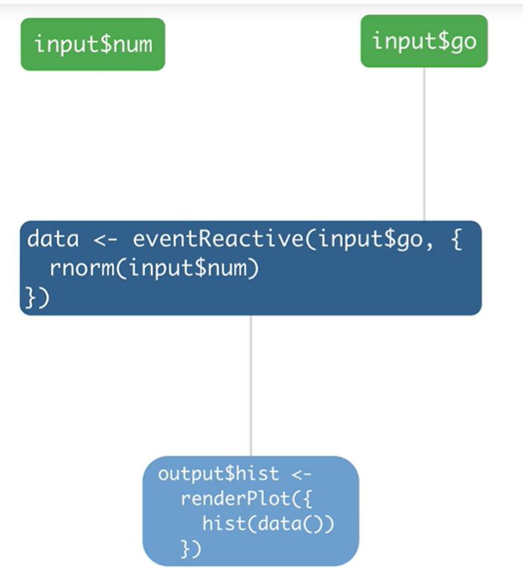
In detail
Notes:
Let’s look at what is going on in detail when we run this application. First, the user will adjust the slider, but input$num isn’t attached to anything, so nothing will happen in the application. Only after the update button is pressed will the eventReactive function be notified that it is invalid. Then it will notify the observer created by output$hist that it is also invalid. The observer will rerun the block of code associated with it and call the reactive expression data. The reactive expression knows that it is invalid and will use the current value of input$num and rerun its code and send that updated value back to the code being run in output$hist. So it still uses the current value, but it is not dependent on it in terms of reactivity.

Slide 27
Eventreactive()
Use eventReactive() to delay reactions
eventReactive() creates a reactive expression
You can specify which reactive values invalidate the reactive expression
Notes:
Just a summary of how to use eventreactive:
-Use eventReactive() to delay reactions
-eventReactive() creates a reactive expression
-You can specify which reactive values invalidate the reactive expression

Slide 28
What if we want to create reactive values?
Notes:
Moving onto our last topic for today, what if we want to create reactive values to use inside of our application? Well, typically R doesn’t allow us to change inputs from a user as it would be kind of strange if for instance we input 50 on a slider and our histogram spit out 100 values. However there may be instances where we want to generate reactive values for some particular output
GO TO LAST EXAMPLE IN R

Slide 29
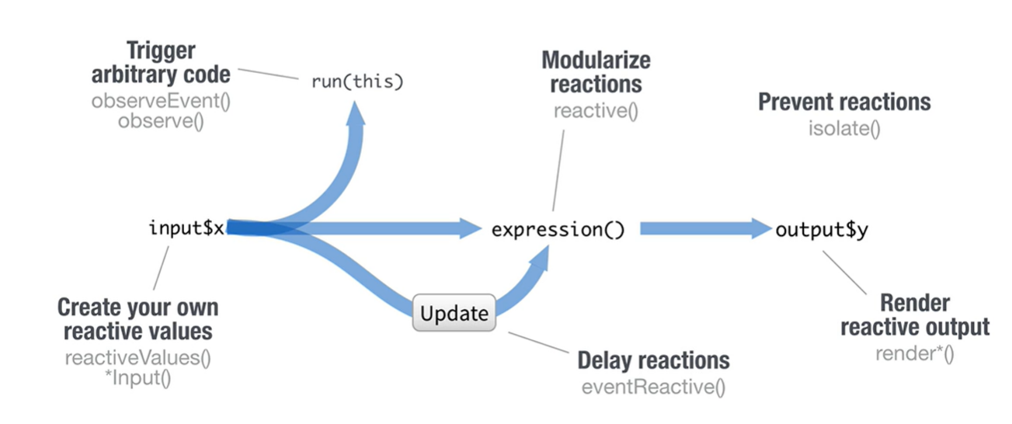
Recap on reactivity
Notes:
So far we have covered how to create reactivity using render functions,
how to extend and modularize that reactivity using the reactive function, and how to break that reactivity using the isolate function, you can trigger arbitrary code using observeEvent or observe, you can delay reactivity using eventReactive, and you can also create your own reactive values for use at the start of a reactive chain.

